Slide 1

Soar Agents for Cyberspace 5/15/2018

Slide 2
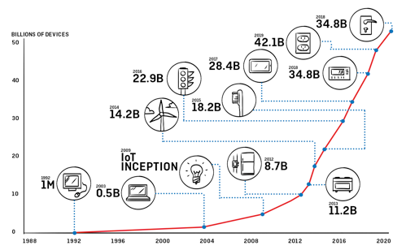

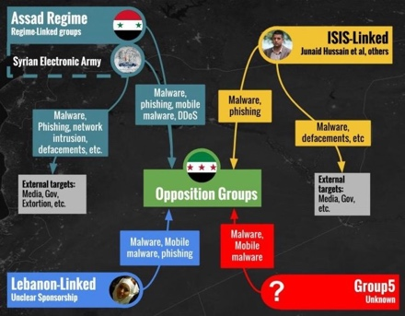
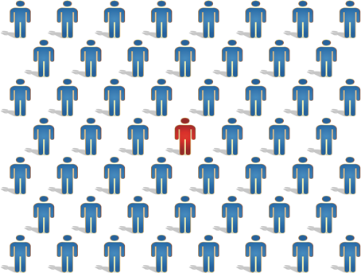
Why Do We Need Cyberspace Cognitive Agents?
Attack Surface Growth
Continuous Security
Threat Complexity
Workforce Shortage

Slide 3
CyCog Agent Genealogy
Cyber Range
TTP Models
CyCog-A
Penetration Tester
General
Agent
CyCog
CyCog-D
Soar
Defender
Cyber Feature Mgmt Sys
CyCog-U
Cyberspace
Denizen
CyCog: Cyber Cognitive
TTP: Tactics, Techniques & Procedures
Notes:
RiDL

Slide 4
Challenges
Enabling Soar agents to use standard tools and applications
Standard off-the-shelf pen-testing tools
Built-in command-line interface (CLI) applications (especially over remote sessions)
Should Soar know all the CLI arguments, or rely on abstraction layers?
Modeling behaviors of (cyberspace) operators
Model abstractions allow reuse across multiple domains
Goal preferences ensure desired goals based on different operators (personas)
How to model/manage/share large sets of adversarial techniques & procedures?
Modeling cyberspace
Documentation of every “thing” the agent sense/acts-on in cyberspace
Sharing models with humans, Soar agents, non-symbolic AI
How to keep track of hosts (etc.) when everything (e.g., IP addresses) can change?

Slide 5
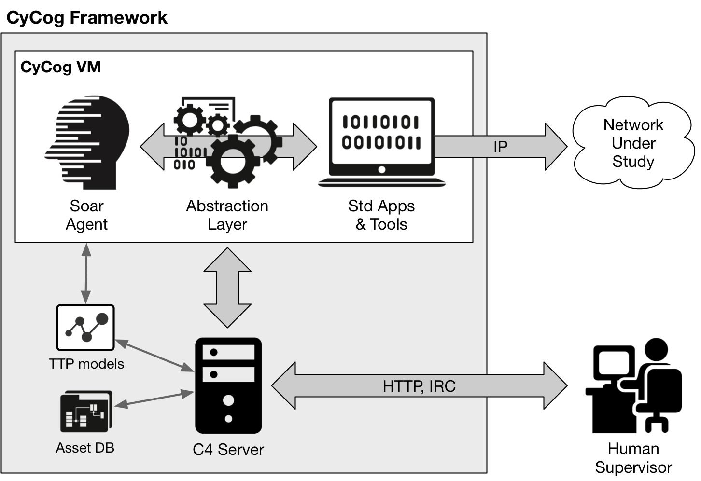
CyCog Architecture
C4: CyCog Command & Control
TTP: Tactics, Techniques & Procedures

Slide 6
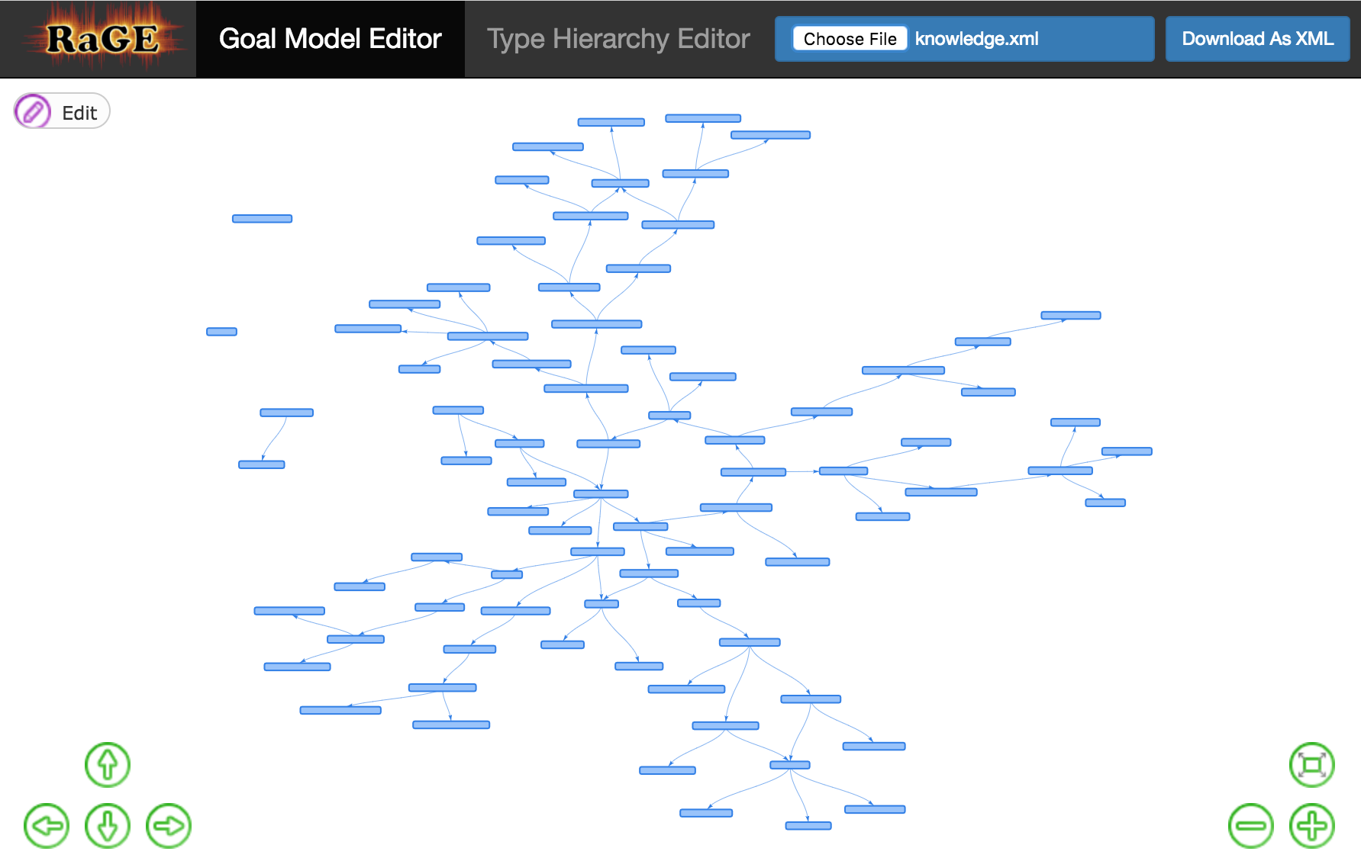
Teaching CyCog New Tricks
SC2RAM Knowledge Model

Slide 7
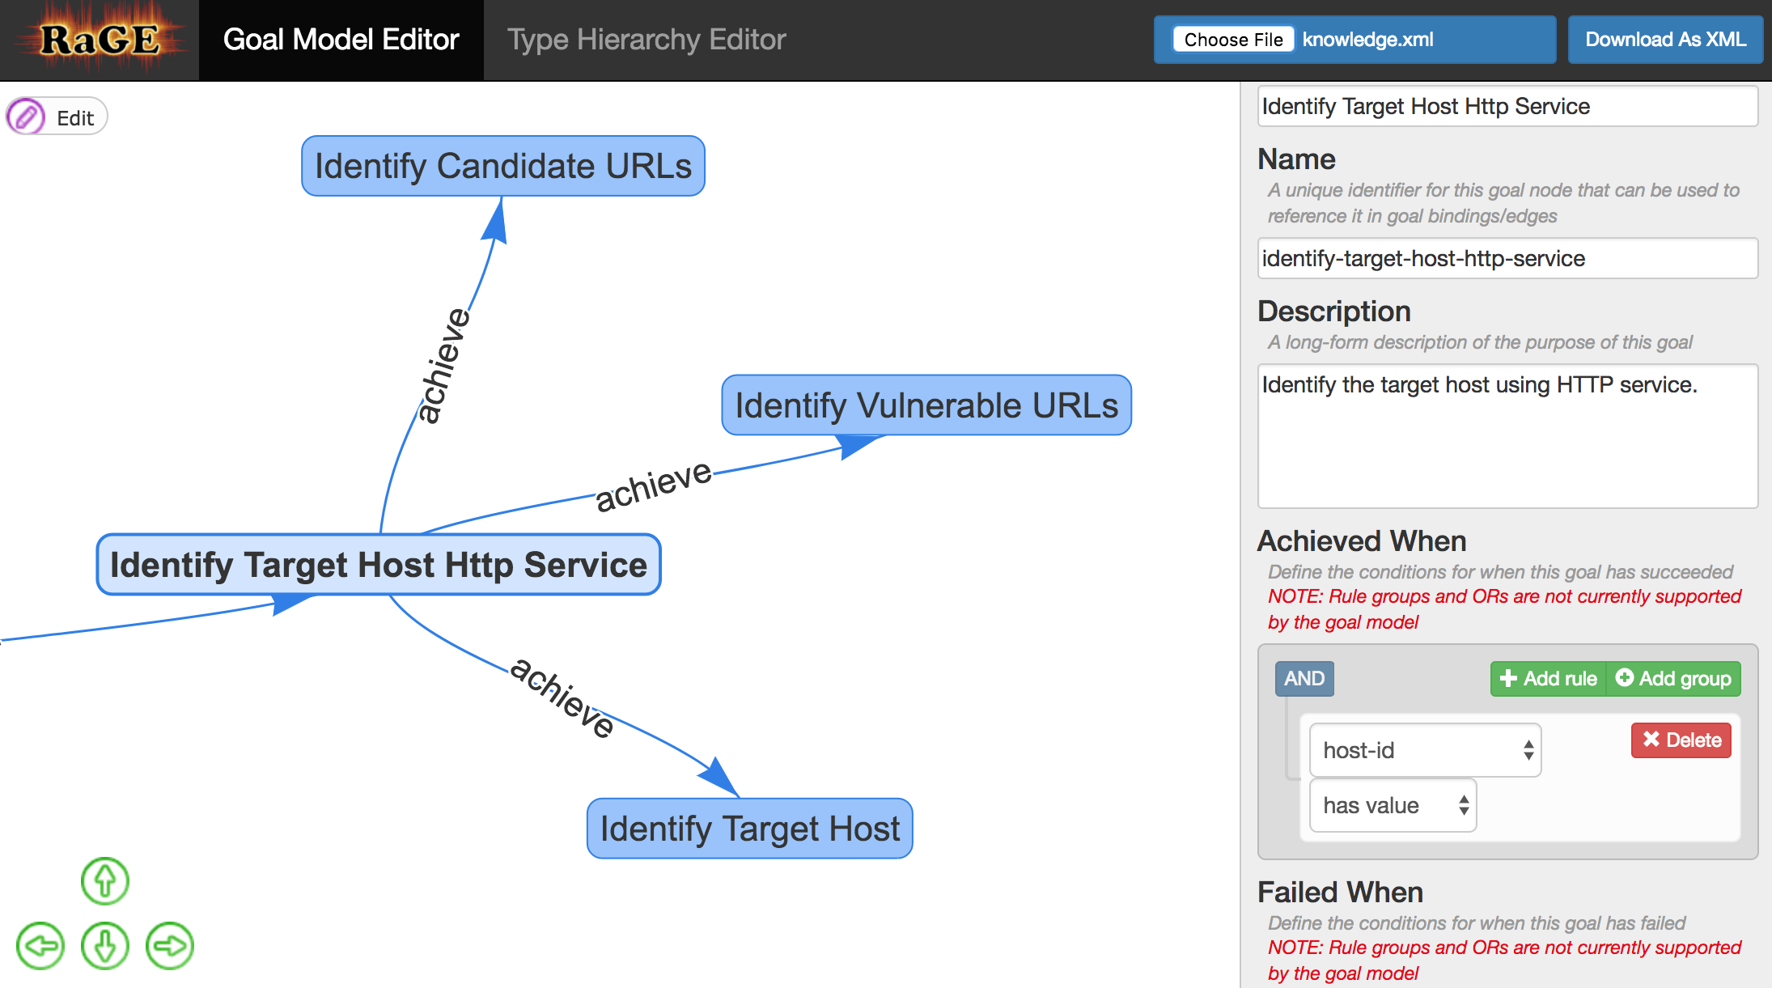
Teaching CyCog New Tricks

Slide 8
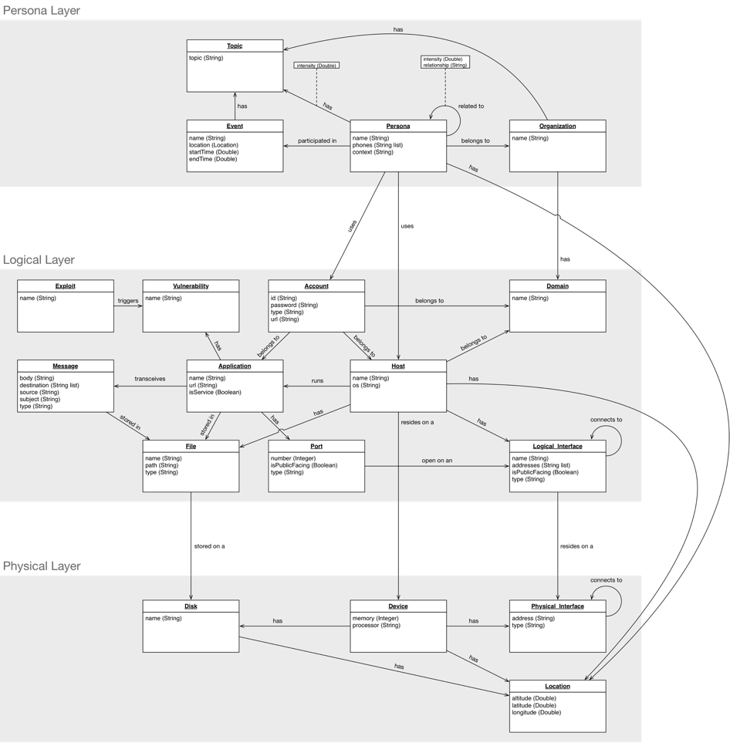
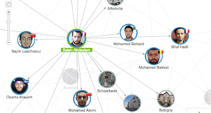
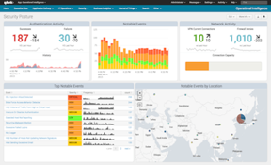
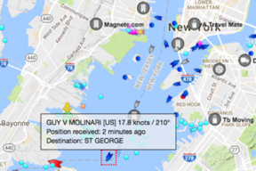
Keeping Track of Cyber Stuff
Cyberspace Layer | Modeling Aspects
Cyber-Persona (Cognitive/ Social) | Personas and Identities (many-to-many) Intent/Goals TTPs, C2 Social presence and communication
Logical | Operating system + drivers Applications (to include malware) Network protocols Events and Logs
Physical | Hardware architecture Physical compute nodes Physical network connections Geo-Location of compute nodes Persona biometrics (key stroke, mouse patterns, facial recognition)
Notes:
Me Alejandro
Orient DB

Slide 9
Demo

Slide 10
Future Work
Improved Mission Planning
RaGE goal editor
Control measures
Temporal Aspects
Soar agents don’t operate at the same speed as human cyberspace operators
Cyberspace is a dynamic environment (i.e., things move around an awful lot)
Open Source
TTP Model & RESTful API
TTP Toolkit
Human-Guided Exploration
User hints
On-the-fly re-tasking

Slide 11
Nuggets
Coal
Only (known) autonomous cyberspace operator
Abstraction layer supports autonomous general users
Expressive user interface
Requires Soar programming for full mission planning
Too few tricks (adversarial techniques & procedures)
Very limited teaming

Slide 12
alex.nickels@soartech.com

